Slide 1
CEN 3078 Computer Security
Module 3 – Defense Architectures and Design

Slide 2
Network Scanning and Vulnerability Scanning
Digital Forensics
Cybersecurity Engineering
Security policies
Firewalls
Authentication, Access controls
Federated trust
IoT/Cloud middleware
Module 3 – Defense Architectures and Design

Slide 3
Network Scanning and Vulnerability Scanning
Digital Forensics
Cybersecurity Engineering
Security policies
Firewalls
Authentication, Access controls
Federated trust
IoT/Cloud middleware
Module 3 – Defense Architectures and Design

Slide 4
Objectives
Understand basic systems engineering concepts
Understand how to integrate systems engineering into cybersecurity
Utilize engineering tools in cybersecurity
Explain the use of standards in cybersecurity engineering

Slide 5
Introduction
The field of cybersecurity is growing rapidly
Presents challenges for defining the profession
Many different approaches are used in cybersecurity and cybersecurity education
  Practiced as a business management discipline
  Approached as a computer science sub-discipline
Wide range of technical backgrounds and skill sets for practitioners
Cybersecurity can be viewed as an engineering discipline—a sub-discipline of systems engineering

Slide 6
Defining Cybersecurity Engineering
Cybersecurity and Systems Engineering
  Cybersecurity involves diverse computer systems, human processes, operating systems, and more
  Cybersecurity could be considered a sub-discipline of systems engineering
  Systems engineering is concerned with a given system, or system of systems, throughout the system life cycle
    Begins with the concept phase and continues through system disposal
    This is an appropriate approach for cybersecurity engineering

Slide 7
Defining Cybersecurity Engineering
Applying Engineering to Cybersecurity
  A cybersecurity project should begin by defining the requirements
  Use the SMART acronym for effective requirements:
    Specific
    Measurable
    Achievable
    Realistic
    Timely
  A tool to aid in planning is the Work Breakdown Structure (WBS), which breaks a project into smaller tasks; see the next slide for an example

Slide 8
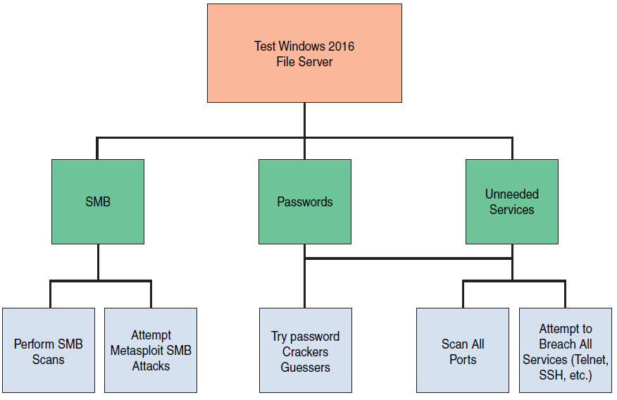
Work Breakdown Structure
Notes:
SMB – Server Message block

Slide 9
Standards
Every engineering discipline has specific standards
Standards in the cybersecurity industry include:
  RMF: Guide for Applying the Risk Management Framework
  ISO 27001: Standard for Information Security Management System (ISMS)
  ISO 27004: How to Measure Information Security
  NIST SP 800-63B: Digital Identity Guidelines

Slide 10
Modeling
Cybersecurity engineering is directed toward some threat
Modeling ensures you are building your security to counter the threats specific to your systems
Different modeling concepts include:
  STRIDE: Identifies threats in six categories
  PASTA: Risk-centric seven-step methodology
  DREAD: Mnemonic for risk rating using five categories (Outdated)

Slide 11
Summary
There are various applications of systems engineering to cybersecurity
The goal is to apply a methodical, systematic approach to cybersecurity
Penetration testing should be a carefully engineered process mapped to specific testing requirements
It is beneficial to model cybersecurity scenarios to better understand system security requirements

Slide 12
Network Scanning and Vulnerability Scanning
Digital Forensics
Cybersecurity Engineering
Security policies
Firewalls
Authentication, Access controls
Federated trust
IoT/Cloud middleware
Module 3 – Defense Architectures and Design

Slide 13
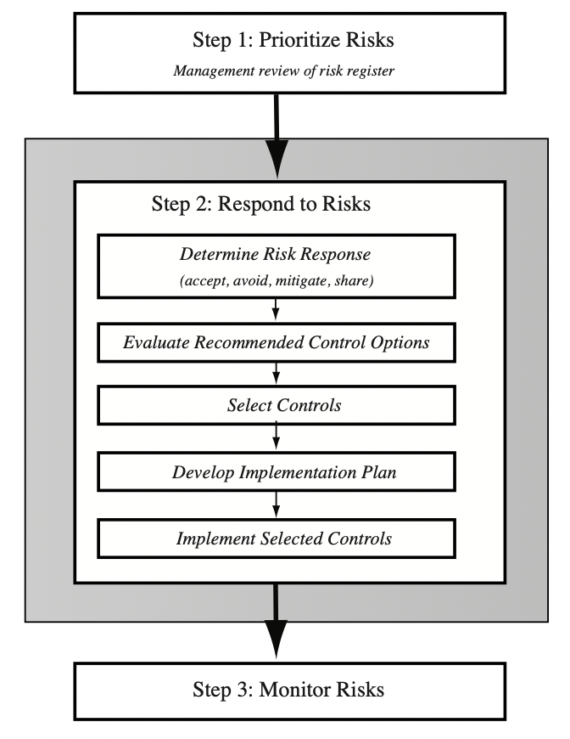
IT Security Management Controls

Slide 14
Security Control
Control is defined as:
“An action, device, procedure, or other measure that reduces risk by eliminating or preventing a security violation, by minimizing the harm it can cause, or by discovering and reporting it to enable corrective action.”
Notes:
A risk assessment on an organization’s IT systems identifies areas needing treatment.
The next step, as shown in Figure 14.1 on risk analysis options, is to select suitable
controls to use in this treatment. An IT security control, safeguard, or countermeasure
(the terms are used interchangeably) helps to reduce risks. We use the following
definition:
“ An action, device, procedure, or other measure that reduces risk by eliminating or preventing a
security violation, by minimizing the harm it can cause, or by discovering and reporting it to enable corrective action.”

Slide 15
Control Classifications
Management controls
  Focus on security policies, planning, guidelines, and standards that influence the selection of operational and technical controls to reduce the risk of loss and to protect the organization’s mission
  These controls refer to issues that management needs to address
Operational controls
  Address the correct implementation and use of security policies and standards, ensuring consistency in security operations and correcting identified operational deficiencies
  These controls relate to mechanisms and procedures that are primarily implemented by people rather than systems
  They are used to improve the security of a system or group of systems
Technical controls
  Involve the security policies on correct use of hardware and software security capabilities in systems
  These range from simple to complex measures that work together to secure critical and sensitive data, information, and IT systems functions
Notes:
Some controls address multiple risks at the same time, and selecting such controls can
be very cost effective. Controls can be classified as belonging to one of the following
classes (although some controls include features from several of these):
• Management controls: Focus on security policies, planning, guidelines, and
standards that influence the selection of operational and technical controls to
reduce the risk of loss and to protect the organization’s mission. These controls
refer to issues that management needs to address. We discuss a number of these
in Chapters 14 and 15.
• Operational controls: Address the correct implementation and use of security
policies and standards, ensuring consistency in security operations and correcting
identified operational deficiencies. These controls relate to mechanisms
and procedures that are primarily implemented by people rather than systems.
They are used to improve the security of a system or group of systems. We will
discuss some of these in Chapters 16 and 17.
• Technical controls: Involve the correct use of hardware and software security
capabilities in systems. These range from simple to complex measures that work
together to secure critical and sensitive data, information, and IT systems functions.

Slide 16
NIST SP800-53 Security Controls
Notes:
Lists of controls are provided in a number of national and international
standards, including ISO 27002 (Code of practice for information security management,
2013), ISO 13335 (Management of information and communications technology
security, 2004), FIPS 200 (Minimum Security Requirements for Federal Information
and Information Systems, March 2006) and NIST SP 800-53 (Recommended Security
Controls for Federal Information Systems, January 2015). There is broad agreement
among these and other standards as to the types of controls that should be used and
the detailed lists of typical controls. Indeed many of the standards cross-reference each
other, indicating their agreement on these lists. ISO 27002 is generally regarded as the
master list of controls and is cited by most other standards. Table 15.1 (adapted from
Table 1 in NIST SP 800-53) is a typical list of families of controls within each of the
classes.

Slide 17
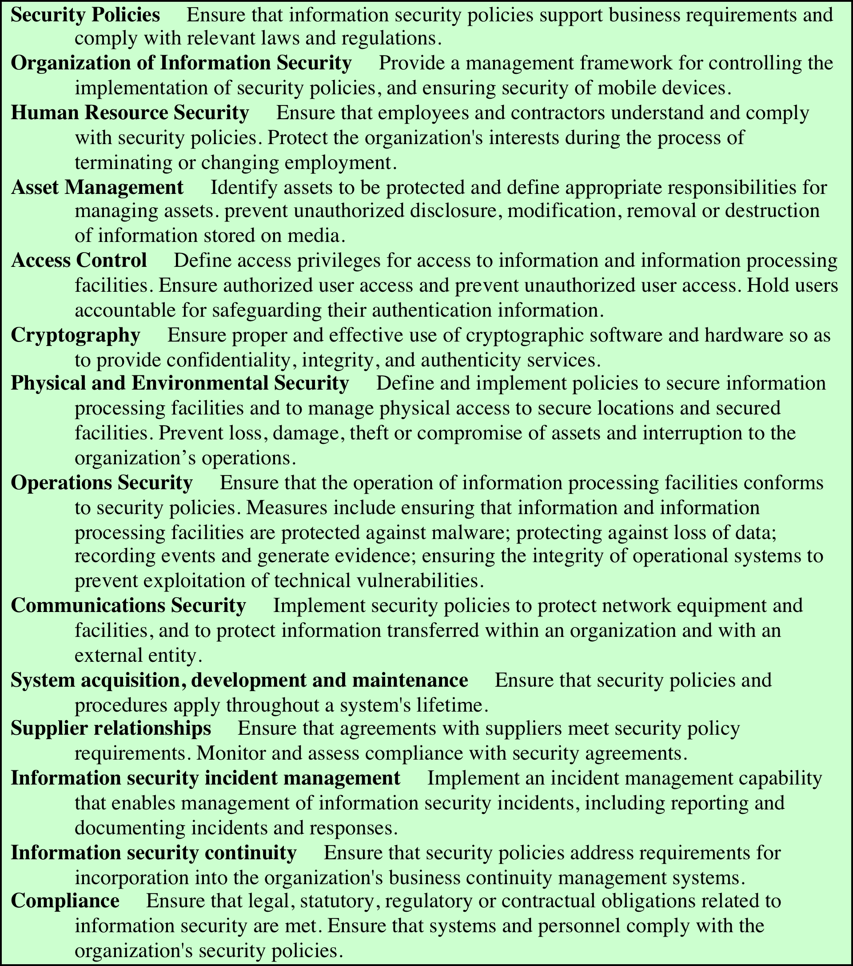
Detailed Security Controls
Notes:
Lists of controls are provided in a number of national and international
standards, including ISO 27002 (Code of practice for information security management,
2013), ISO 13335 (Management of information and communications technology
security, 2004), FIPS 200 (Minimum Security Requirements for Federal Information
and Information Systems, March 2006) and NIST SP 800-53 (Recommended Security
Controls for Federal Information Systems, January 2015). There is broad agreement
among these and other standards as to the types of controls that should be used and
the detailed lists of typical controls. Indeed many of the standards cross-reference each
other, indicating their agreement on these lists. ISO 27002 is generally regarded as the
master list of controls and is cited by most other standards. Table 15.1 (adapted from
Table 1 in NIST SP 800-53) is a typical list of families of controls within each of the
classes.

Slide 18
Detailed Security Controls (2)
Notes:
Lists of controls are provided in a number of national and international
standards, including ISO 27002 (Code of practice for information security management,
2013), ISO 13335 (Management of information and communications technology
security, 2004), FIPS 200 (Minimum Security Requirements for Federal Information
and Information Systems, March 2006) and NIST SP 800-53 (Recommended Security
Controls for Federal Information Systems, January 2015). There is broad agreement
among these and other standards as to the types of controls that should be used and
the detailed lists of typical controls. Indeed many of the standards cross-reference each
other, indicating their agreement on these lists. ISO 27002 is generally regarded as the
master list of controls and is cited by most other standards. Table 15.1 (adapted from
Table 1 in NIST SP 800-53) is a typical list of families of controls within each of the
classes.

Slide 19
Detailed Security Controls (3)
Notes:
Lists of controls are provided in a number of national and international
standards, including ISO 27002 (Code of practice for information security management,
2013), ISO 13335 (Management of information and communications technology
security, 2004), FIPS 200 (Minimum Security Requirements for Federal Information
and Information Systems, March 2006) and NIST SP 800-53 (Recommended Security
Controls for Federal Information Systems, January 2015). There is broad agreement
among these and other standards as to the types of controls that should be used and
the detailed lists of typical controls. Indeed many of the standards cross-reference each
other, indicating their agreement on these lists. ISO 27002 is generally regarded as the
master list of controls and is cited by most other standards. Table 15.1 (adapted from
Table 1 in NIST SP 800-53) is a typical list of families of controls within each of the
classes.

Slide 20
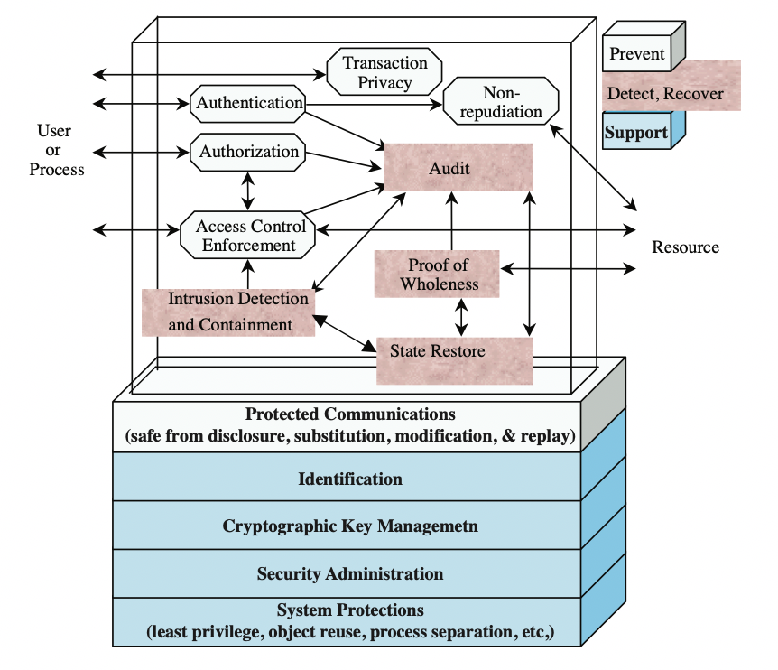
Technical Security Controls
Notes:
Some controls address multiple risks at the same time, and selecting such controls can
be very cost effective. Controls can be classified as belonging to one of the following
classes (although some controls include features from several of these):
• Management controls: Focus on security policies, planning, guidelines, and
standards that influence the selection of operational and technical controls to
reduce the risk of loss and to protect the organization’s mission. These controls
refer to issues that management needs to address. We discuss a number of these
in Chapters 14 and 15.
• Operational controls: Address the correct implementation and use of security
policies and standards, ensuring consistency in security operations and correcting
identified operational deficiencies. These controls relate to mechanisms
and procedures that are primarily implemented by people rather than systems.
They are used to improve the security of a system or group of systems. We will
discuss some of these in Chapters 16 and 17.
• Technical controls: Involve the correct use of hardware and software security
capabilities in systems. These range from simple to complex measures that work
together to secure critical and sensitive data, information, and IT systems functions.

Slide 21
IT Security Plan
Should include
Risks, recommended controls, action priority
Selected controls, resources needed
Responsible personnel, implementation dates
Maintenance requirements
Provides details of:
What will be done
  What resources are needed
  Who is responsible
  Goal is to detail the actions needed to improve the identified deficiencies in the risk profile
Notes:
Having identified a range of possible controls from which management has selected
some to implement, an IT security plan should then be created, as indicated in
Figures 14.1 and 15.1 . This is a document that provides details as to what will be
done, what resources are needed, and who will be responsible. The goal is to detail
the actions needed to improve the identified deficiencies in the organization’s risk
profile in a timely manner. NIST SP 800-30 (Risk Management Guide for Information Technology
Systems, September 2012) suggests that this plan should include details of:
• Risks (asset/threat/vulnerability combinations)
• Recommended controls (from the risk assessment)
• Action priority for each risk
• Selected controls (on the basis of the cost-benefit analysis)
• Required resources for implementing the selected controls
• Responsible personnel
• Target start and end dates for implementation
• Maintenance requirements and other comments

Slide 22
Security Plan Implementation
Notes:
These details are summarized in an implementation plan table, such as
that shown in Table 15.4 . This illustrates an example implementation plan for
the example risk identified and shown in Table 14.5 . The suggested controls are
specific examples of remote access, auditable event, user identification, system
backup, and configuration change controls, applied to the identified threatened
asset. All of them are chosen, because they are neither costly nor difficult to
implement. They do require some changes to procedures. The relevant network
administration staff must be notified of these changes. Staff members may also
require training on the correct implementation of the new procedures and their
rights and responsibilities.

Slide 23
Security Plan Implementation (2)
IT security plan documents:
What needs to be done for each selected control
Personnel responsible
Resources and time frame
Identified personnel:
Implement new or enhanced controls
May need system configuration changes, upgrades or new system installation
May also involve development of new or extended procedures
Need to be encouraged and monitored by management
When implementation is completed management authorizes the system for operational use
Notes:
The next phase in the IT security management process, as indicated in Figure 14.1, is
to manage the implementation of the controls detailed in the IT security plan. This
comprises the do stage of the cyclic implementation model discussed in Chapter 14 .
The implementation phase comprises not only the direct implementation of the
controls as detailed in the security plan, but also the associated specific training and
general security awareness programs for the organization.
The IT security plan documents what needs to be done for each selected control,
along with the personnel responsible, and the resources and time frame to
be used. The identified personnel then undertake the tasks needed to implement
the new or enhanced controls, be they technical, managerial, or operational.
This may involve some combination of system configuration changes, upgrades,
or new system installation. It may also involve the development of new or
extended procedures to document practices needed to achieve the desired
security goals. Note that even technical controls typically require associated
operational procedures to ensure their correct use. The use of these procedures
needs to be encouraged and monitored by management.
The implementation process should be monitored to ensure its correctness.
This is typically performed by the organizational security officer, who checks that:
• The implementation costs and resources used stay within identified bounds.
• The controls are correctly implemented as specified in the plan, in order that
the identified reduction in risk level is achieved.
• The controls are operated and administered as needed.
When the implementation is successfully completed, management needs to
authorize the system for operational use. This may be a purely informal process
within the organization. Alternatively, especially in government organizations,
this may be part of a formal process resulting in accreditation of the system
as meeting required standards. This is usually associated with the installation,
certification, and use of trusted computing system, as we will discuss in Chapter 27 .
In these cases an external accrediting body will verify the documented evidence of
the correct design and implementation of the system.

Slide 24
Security Plan Implementation Follow-up
Security management is a cyclic process
  Constantly repeated to respond to changes in the IT systems and the risk environment
Need to monitor implemented controls
Evaluate changes for security implications
  Otherwise increase chance of security breach
Includes a number of aspects
Maintenance of security controls
Security compliance checking
Change and configuration management
Incident handling
Notes:
The IT security management process does not end with the implementation of
controls and the training of personnel. As we noted in Chapter 14, it is a cyclic
process, constantly repeated to respond to changes in the IT systems and the risk
environment. The various controls implemented should be monitored to ensure
their continued effectiveness. Any proposed changes to systems should be checked
for security implications and the risk profile of the affected system reviewed if
necessary. Unfortunately, this aspect of IT security management often receives
the least attention and in many cases is added as an afterthought, if at all. Failure
to do so can greatly increase the likelihood that a security failure will occur.
This follow-up stage of the management process includes a number of aspects:
• Maintenance of security controls
• Security compliance checking
• Change and configuration management
• Incident handling
Any of these aspects might indicate that changes are needed to the previous stages in
the IT security management process. An obvious example is that if a breach should
occur, such as a virus infection of desktop systems, then changes may be needed to
the risk assessment, to the controls chosen, or to the details of their implementation.
This can trigger a review of earlier stages in the process.

Slide 25
Security Plan Maintenance
Need continued maintenance and monitoring of implemented controls to ensure continued correct functioning and appropriateness
Goal is to ensure controls perform as intended
Periodic review of controls
Upgrade of controls to meet new requirements
System changes do not impact controls
Address new threats or vulnerabilities
Notes:
The first aspect concerns the continued maintenance and monitoring of the
implemented controls to ensure their continued correct functioning and
appropriateness. It is important that someone has responsibility for this maintenance
process, which is generally coordinated by the organization’s security officer.
The maintenance tasks include ensuring that:
• Controls are periodically reviewed to verify that they still function as intended.
• Controls are upgraded when new requirements are discovered.
• Changes to systems do not adversely affect the controls.
• New threats or vulnerabilities have not become known.
This review includes regular analysis of log files to ensure various system
components are functioning as expected, and to determine a baseline of activity
against which abnormal events can be compared when handling incidents.
We discuss security auditing further in Chapter 18 .
The goal of maintenance is to ensure that the controls continue to perform as
intended, and hence that the organization’s risk exposure remains as chosen. Failure
to maintain controls could lead to a security breach with a potentially significant
impact on the organization.

